Slide 1
Chromatography

Slide 2
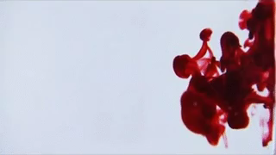
By the end of this Smart Lesson, you should be able to:
1. | Explain what chromatography is.
2. | Explain how paper chromatography can be used to separate out pigments from dyes and inks.
3. | Identify similarities between substances based on chromatography results.

Slide 3
Different solutes have different properties and therefore will travel through other substances at different speeds.
For example, solutes with large particles will not travel quickly, because they constantly bump into other particles.

Slide 4
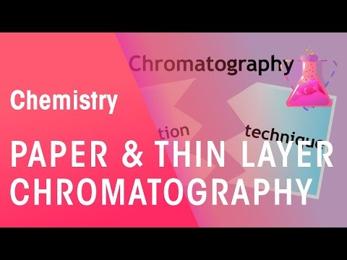

Slide 5
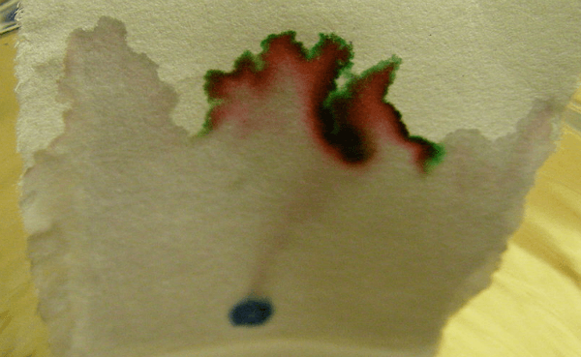
One type of chromatography is paper chromatography.
A solution is dotted on the end of a piece of special chromatography paper. The very edge of the paper is then dipped into a solvent, such as water.

Slide 6
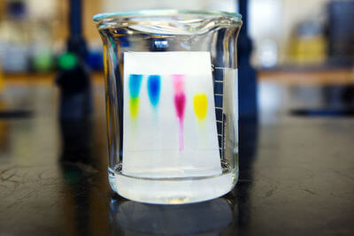
The solvent then moves up the paper, taking the solution with it.
The different parts of the mixture move at different rates, which separates them. Smaller substances travel further than larger substances.
This is generally used to compare unknown substances to known substances, as identical solutions will have the same pattern.

Slide 7
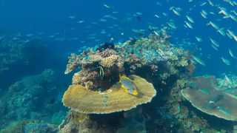
To help explain chromatography, imagine a fish and a whale trying to make their way through a coral reef.
A fish will have an easy time, since they can move forward through any tiny gap in the coral.
However a whale has to find only the largest paths, since it can't fit through anything else.

Slide 8
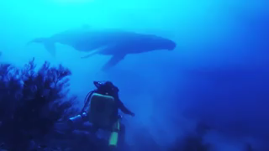
In paper chromatography, chemicals on the paper are caught up in a wave of water moving up the paper.
Small particles are going to have an easier time moving through the paper than large particles, much like the fish and the whale.

Slide 9

Chromatography is most commonly used to separate pigments in a solution.
A pigment is a material that produces a certain colour. Different pigments can be mixed in different ways to make a huge variety of colours.
Ink in pens, food and fabric dye contain different pigments.

Slide 10
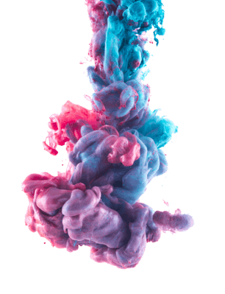
Pigments come in all sorts of shapes and sizes.
As with other particles, larger pigments will not be able to travel as far up the paper as smaller pigments. This allows us to see all of the different pigments that are used in a dye or ink. The image to the right shows blue and pink pigments mixing together to create purple. Chromatography allows us to separate these colours and see each individually.

